Slide 1

INTRO TO JavaScript
GIRLSCRIPT EDUCATION OUTREACH PROGRAM

Slide 2
TOPICS TO COVER:
What is JS?
What can we do with JS?
Future scope
Browser Console
Writing “Hello World” in JS
Data Types
JS in webpages
NodeJS Installation

Slide 3
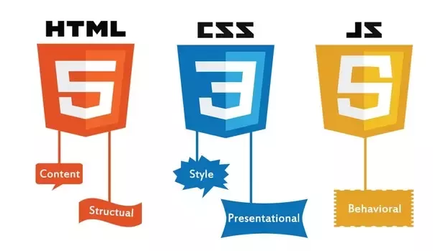
1. What is JS ?
JavaScript is a dynamically typed programming language.
JavaScript was initially created to “make web pages alive”.
JavaScript can run on browsers.
Full integration with HTML/CSS.
Today, JavaScript can execute not only in the browser, but also on the server, or actually on any device that has a special program called the JavaScript engine.

Slide 4
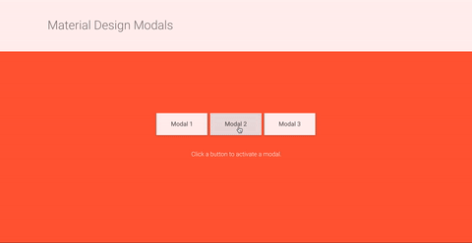


Image source

Slide 5
2. What can we do with JS ?
Along with HTML and CSS, JavaScript forms the basis of front-end web development.
Create interactive elements for web pages, enhancing the user experience.
Things like: menus, animations, video players, interactive maps, and even simple in-browser games.
JavaScript can also run on servers via NodeJS , hence being a great option for back-end development as well.

Slide 6
Interactive
Web Elements
Image source

Slide 7
Dynamic Websites
&
Webapps
https://uijar.com/uploads/post/image/62/netflix_jobs-2-min.gif

Slide 8
3. Future Scope
Empowers Over 95% of The Web
Readily available packages and libraries.
Excellent Choice of Frameworks : AngularJS, Ember.js Metero.js, ReactJS, and VueJS
Job profiles:
Front End Web Developer , Web Developer , UI/UX Designer , Full Stack Developer

Slide 9
Progressive Web Apps (PWA)
Cross Platform Apps (with ReactNative)
Image source
Image source

Slide 10
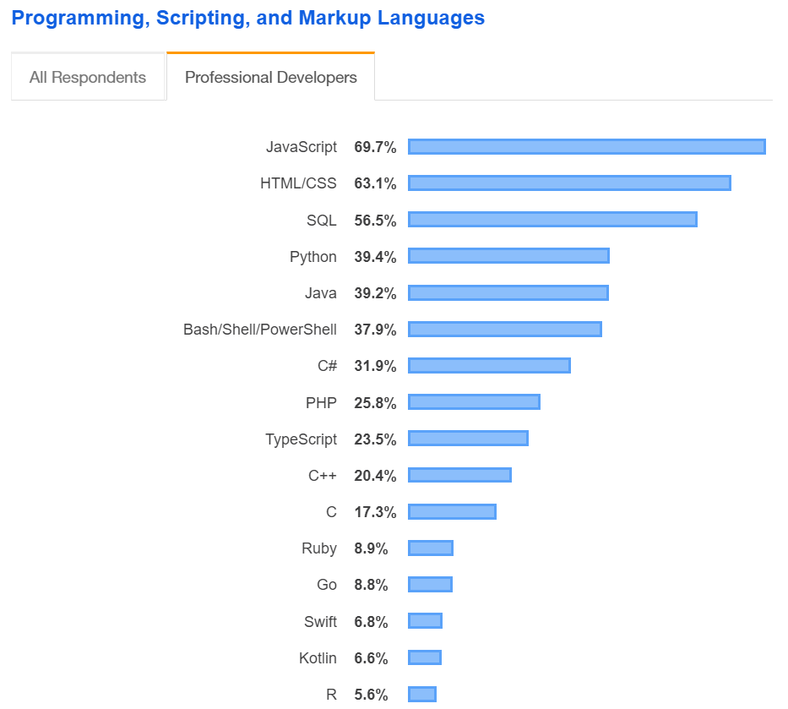
Most Popular Technologies
Stack Overflow Insights Survey 2019)
https://insights.stackoverflow.com/survey/2019#technology

Slide 11
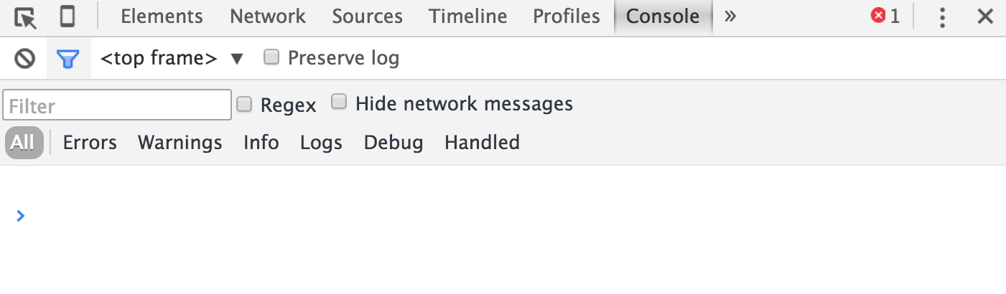
4. Developer Console
Web browsers have Developer console meant for us developers to see console errors and run our own JavaScript.
The exact look of developer tools depends on the browser being used. The look & feel of them is quite similar.

Slide 12
5. Writing “Hello World” in JS
Press F12 or, If you’re on Mac, then Cmd+Opt+J
The developer tools will open on the Console tab by default.
Use console.log() function to print something on console.
In our example: console.log(“Hello World ! “)

Slide 13

6. Data Types in JS
Variable : stores a data value
variable declaration and assignment:
var message = 'Hello';
var message;
message = 'Hello’;
// These two lines of code is equivalent to the code example on top.

Slide 14
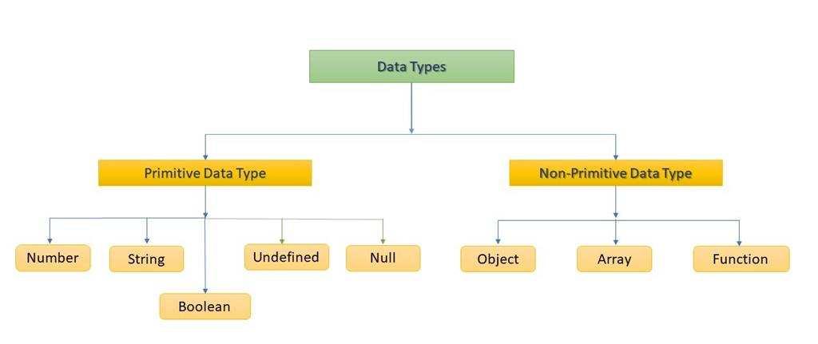
4
3.14
0
-4
-3.14
“ Hi ! “
‘ Hi ! ‘
‘34’
‘-3.14’
‘Hi 24/7’
{
name : “John”,
age : 34,
isStudent : true
}
[“apple”, “grapes”, “cherry” ]
true
false

Slide 15
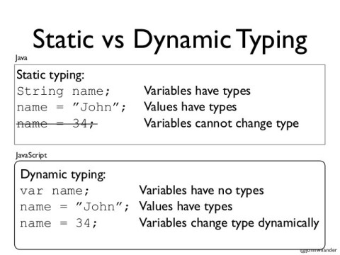
So . . what is dynamic typing?
A variable in JavaScript can contain any data. A variable can at one moment be a string and at another be a number
Programming languages that allow such variable declaration without explicitly mentioned data type are called “dynamically typed”.
http://techtales.co/2017/09/05/dynamic-typing-vs-static-typing-mean/

Slide 16
7. JS in webpage
JavaScript was made to be integrated with HTML/CSS, to make webpages interactive.
<script> tag is used to put our JS code in a HTML web page.
Two ways of running JS in webpage:
Internal JS
(writing JS code within HTML file)
External JS
(writing JS code in separate JS file , then linking with HTML file)

Slide 17
INTERNAL JS
EXTERNAL JS
alert( 'Hello, world!' );
script.js
<!DOCTYPE HTML>
<html>
<body>
Internal JS in HTML webpage
<script>
alert( 'Hello, world!' );
</script>
</body>
</html>
<!DOCTYPE HTML>
<html>
<body>
External JS in HTML webpage
<script src="/path/to/script.js">
</script>
</body>
</html>
MySite.html
MySite.html

Slide 18
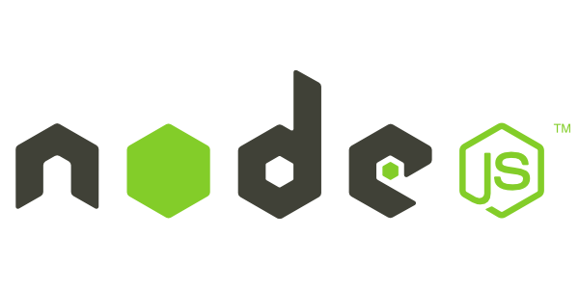
8. NodeJS Installation
What is Node.JS ?
“ Node.js is a JavaScript runtime environment that executes JavaScript code outside of a web browser. “
Why Node.JS ?
Being able to run JS outside browsers, directly on servers, allows developers to use JS as a server-side programming language.
It's used for traditional web sites and back-end API services

Slide 19
Installation
Ubuntu (Linux) :
Open your terminal.
To install node.js use the following command:
Windows:
Goto https://nodejs.org/en/download/ . Select “Windows Installer”.
Run setup.
Once installed, verify it by checking the installed version using the following command:
or
sudo apt install nodejs
node -v
node --version

Slide 20
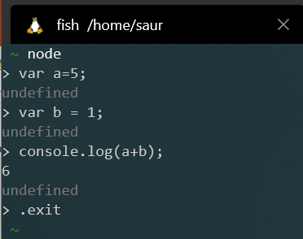
Executing JS via Node.js
Ubuntu (Linux) :
Open your terminal.
To run code from a .js file use the following command:
To type JS directly in the terminal for execution type:
To exit node mode, press ctrl+c or type .exit
node /path/to/script.js
node

